Slide 1
ONLINE MOVIE TICKET BOOKING AND INFO
Presented by
Shiva Kumar Pentyala
Ritesh Kumar Reddy Kuchukulla Sundeep Kumar Allampally Sandeep Blv

Slide 2
Overview:
Online Movie Ticket booking, serves as an all in one system which deals with most of the aspects of current day online ticket booking.
With this customers can check and book movie tickets online from anywhere through their devices.
Main benefits of this application are enhancement of the effectiveness, automation of the actives there by reducing manual entries and making it user friendly.

Slide 3
EXECUTION:
The home page displays different movies and can be used for USERS and ADMIN to login.
When user logs inn he can see various options like search movies , movies, theatres , change password , review , coupon, logout.
searchmovies search by theatre name, search by movie name
wanted selection of theatre and movie is selected
required date and time is selected
number of tickets and seat selection is done
card details are given
the ticket is printed with the details

Slide 4
When admin logs inn he can add or delete the content like the news , coupons ,existing users, movies in theatres etc.,

Slide 5
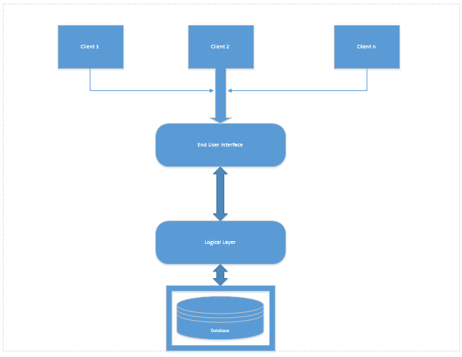
Architecture of the system:

Slide 6
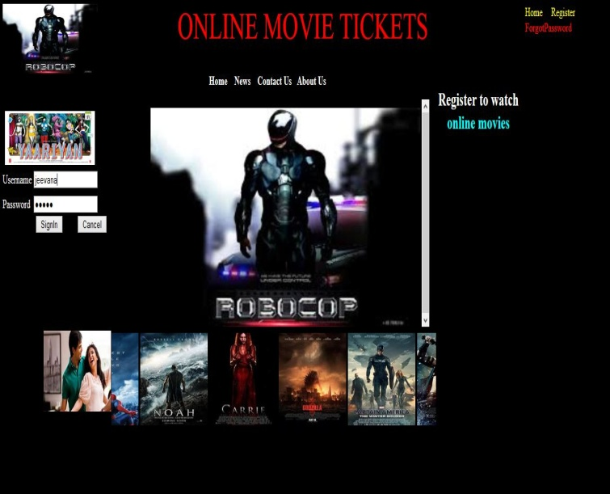
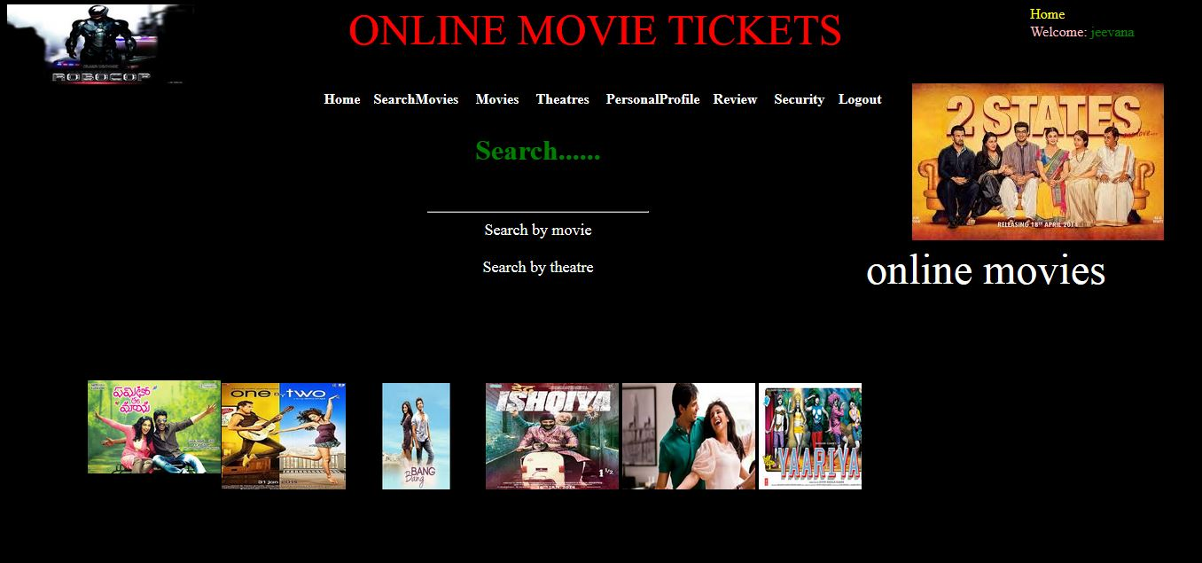
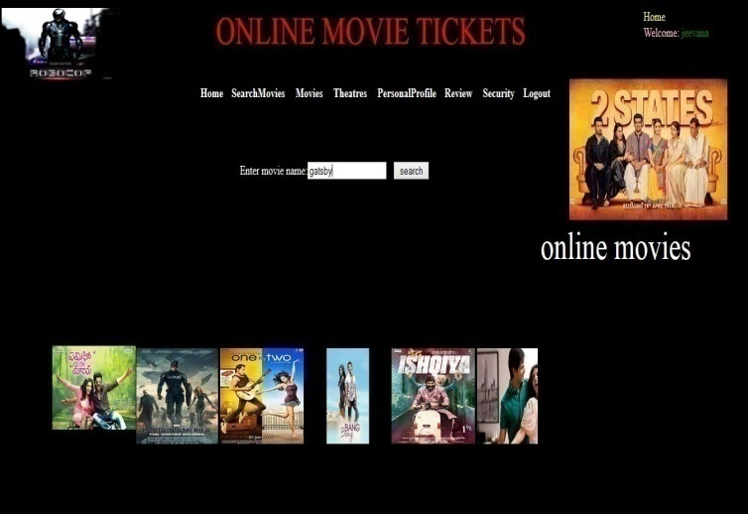
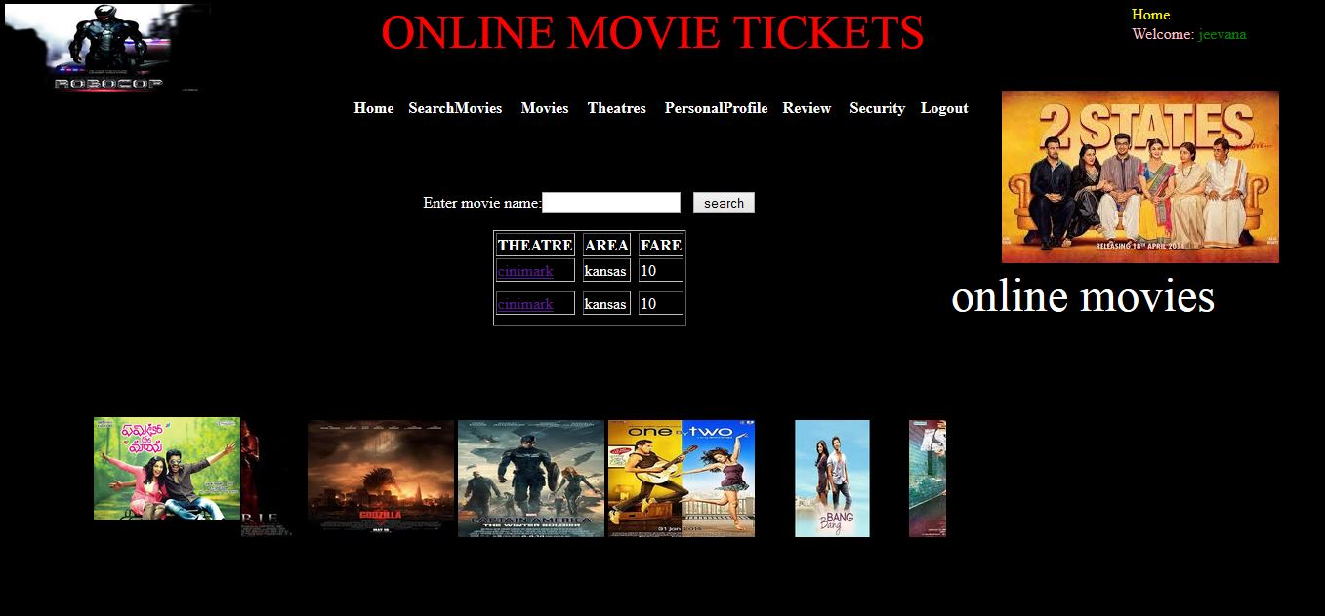

Slide 7
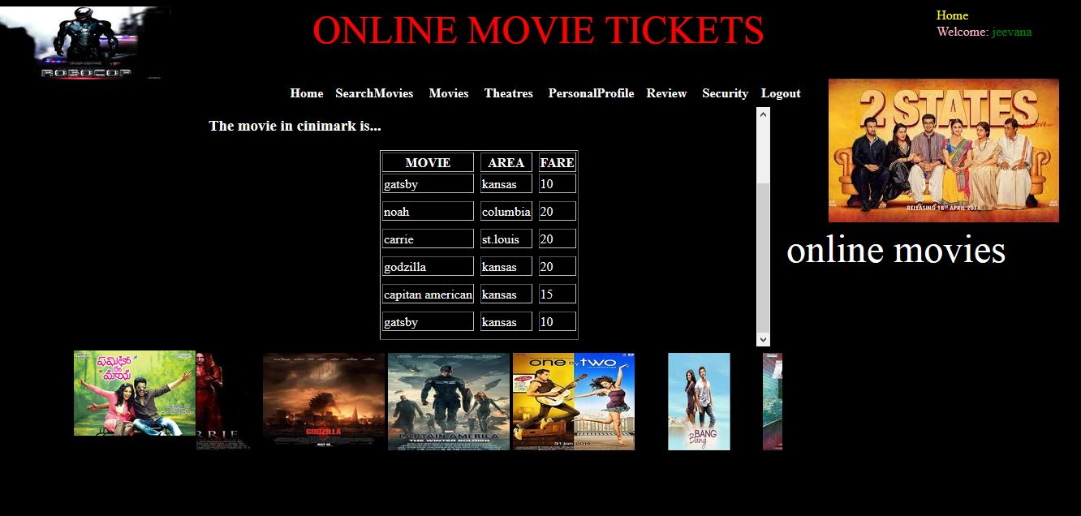
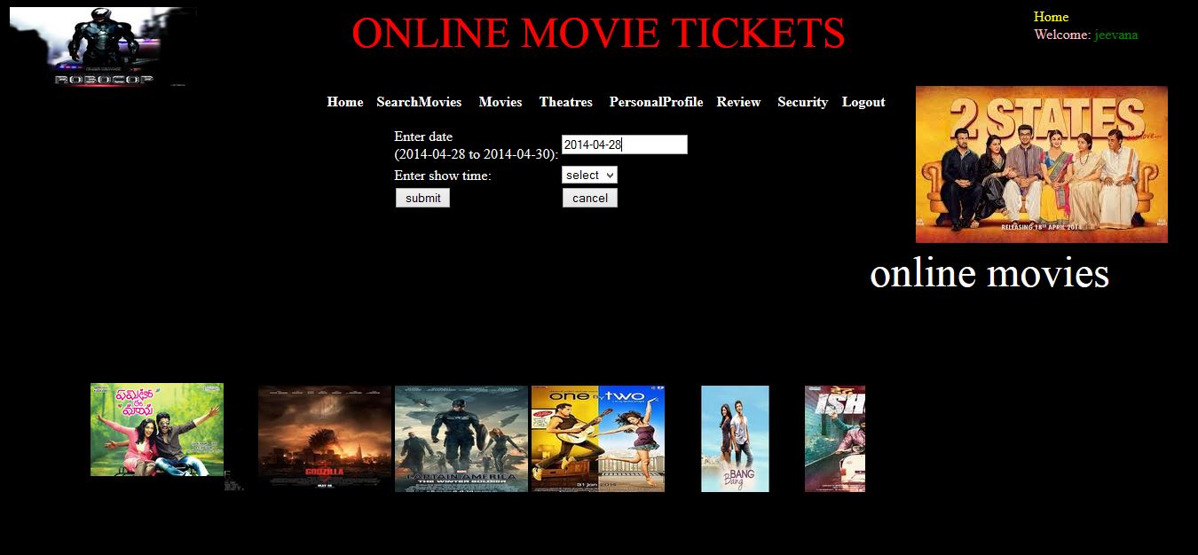
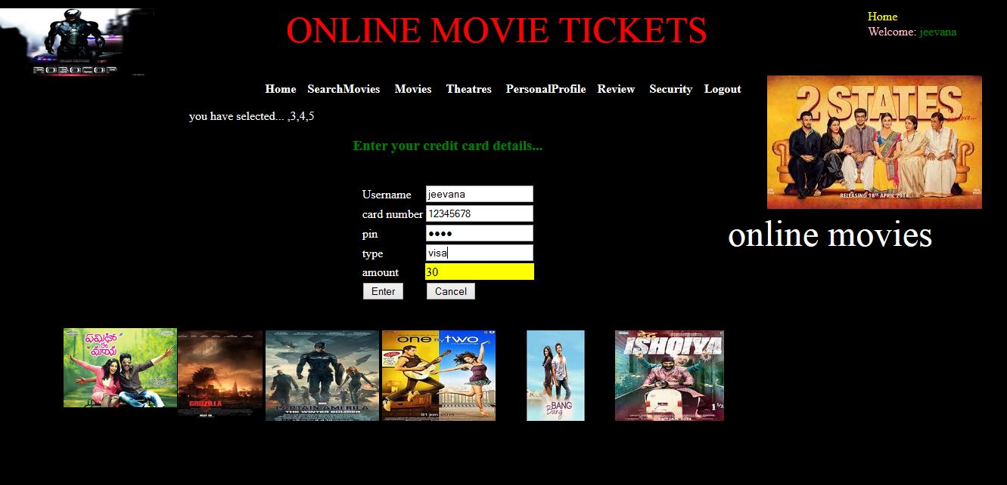
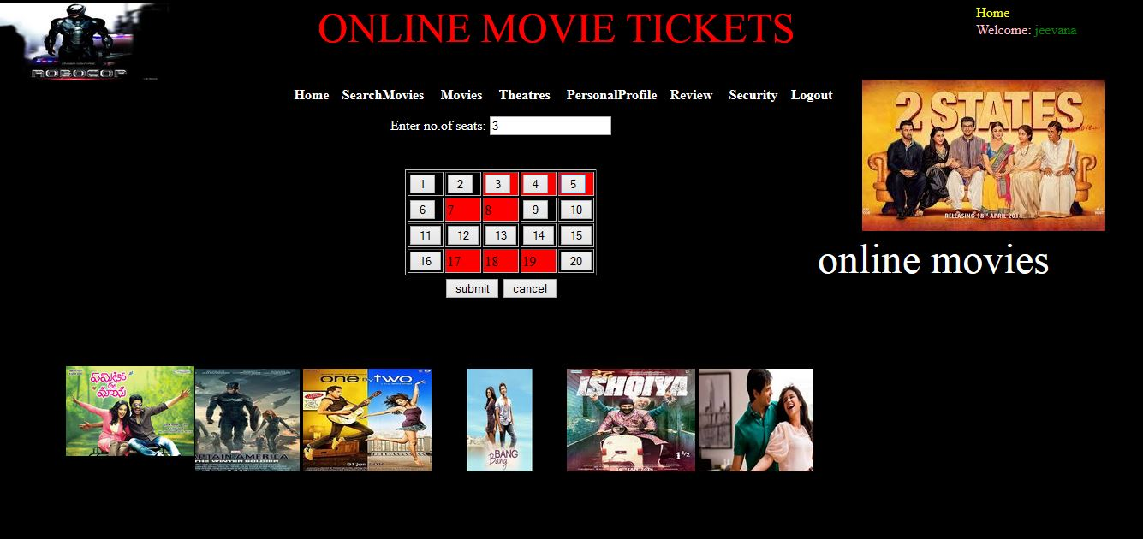

Slide 8
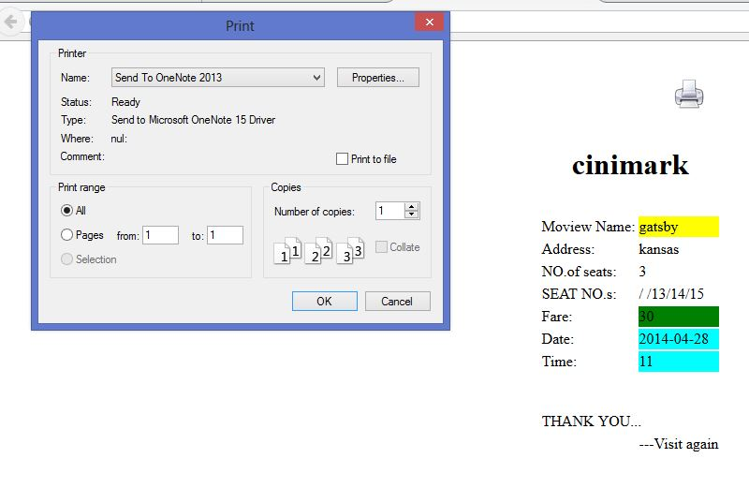
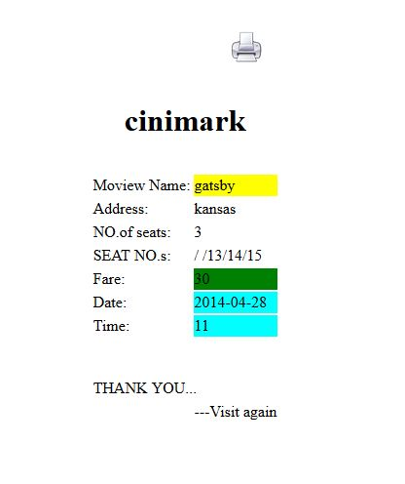
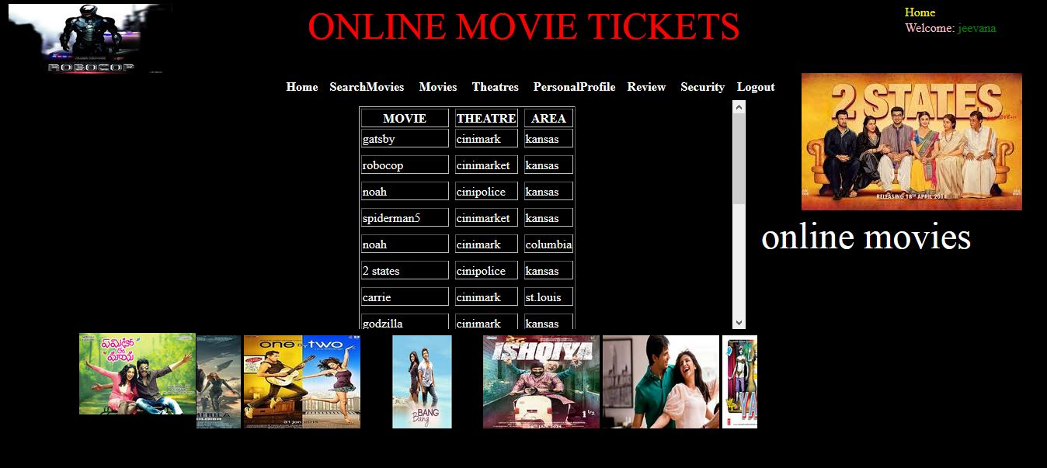
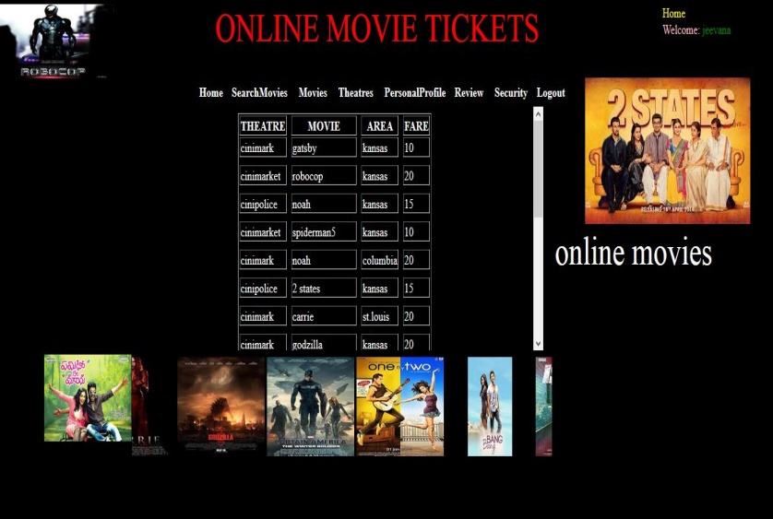

Slide 9
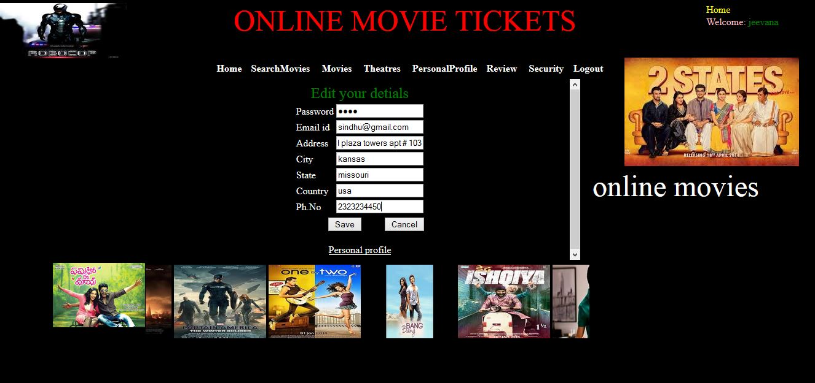
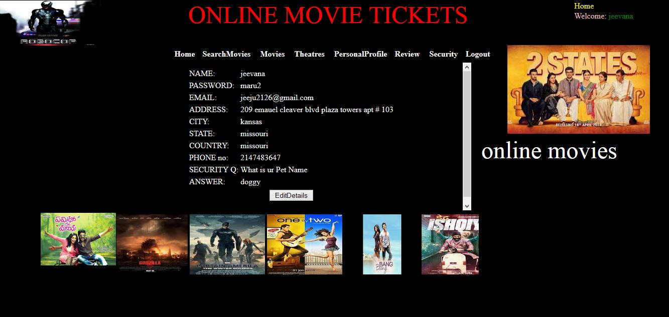
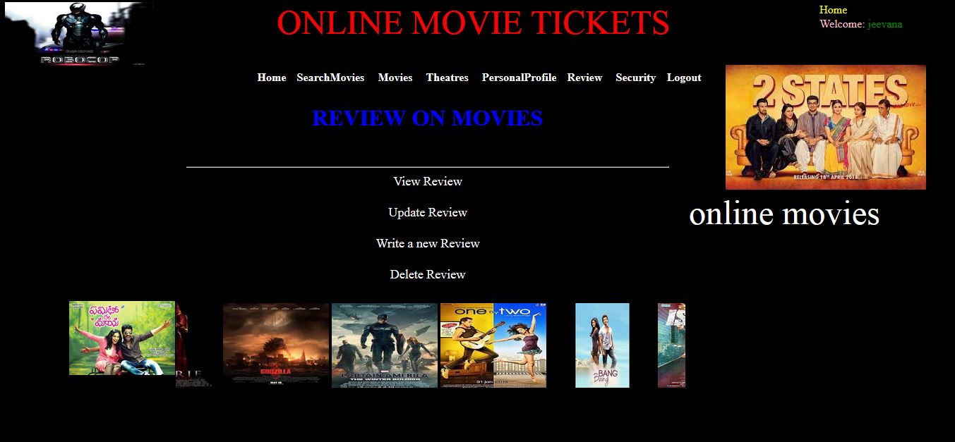
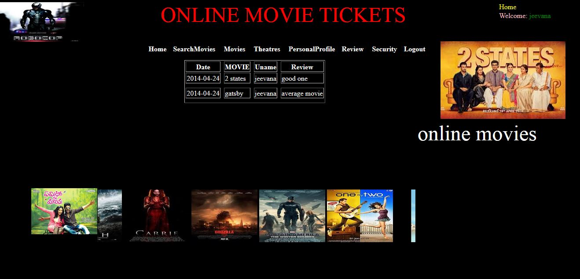

Slide 10
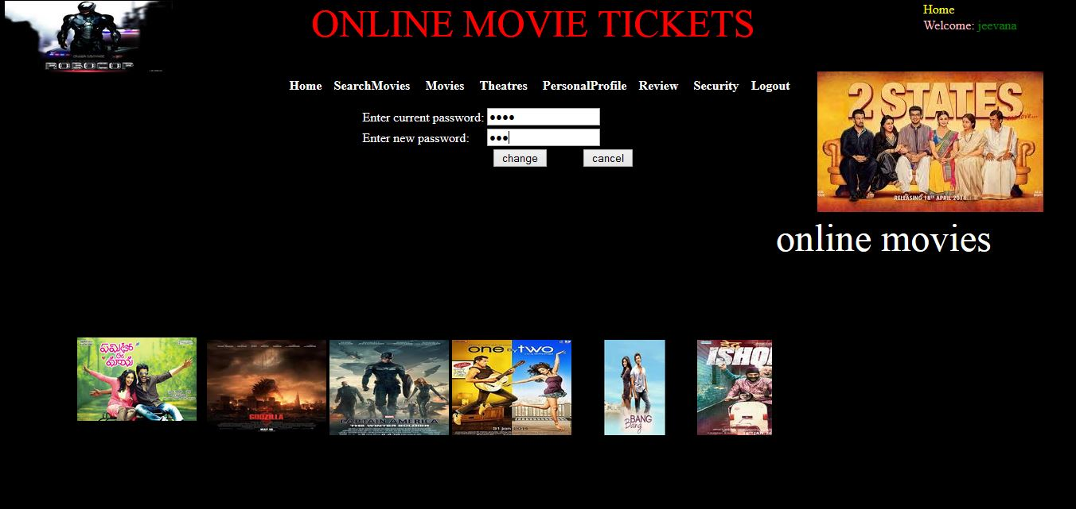
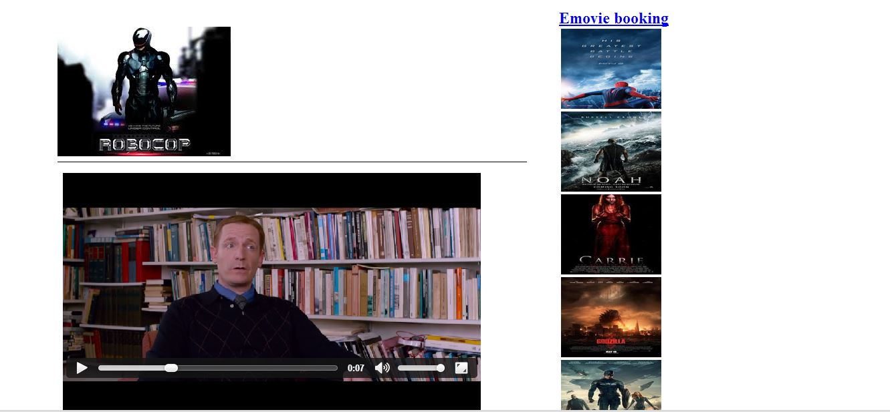
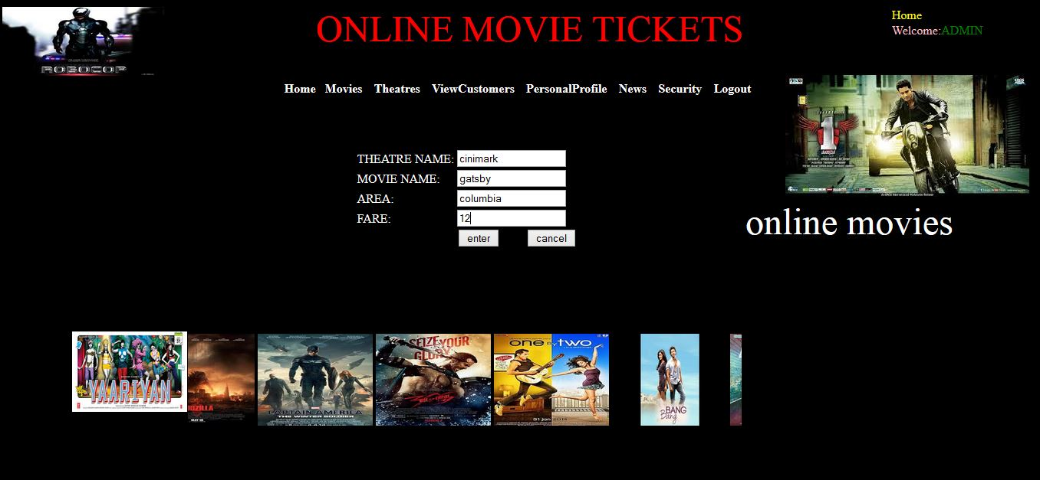
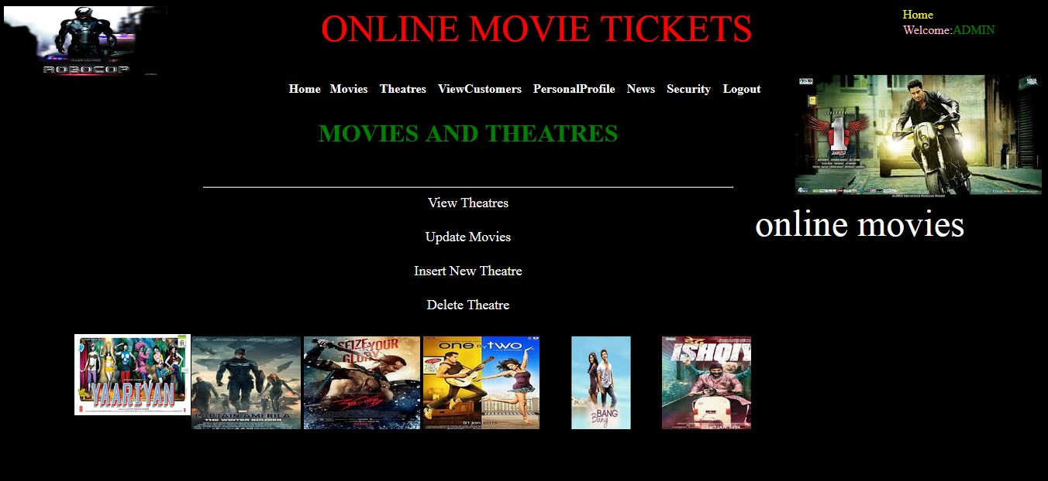

Slide 11
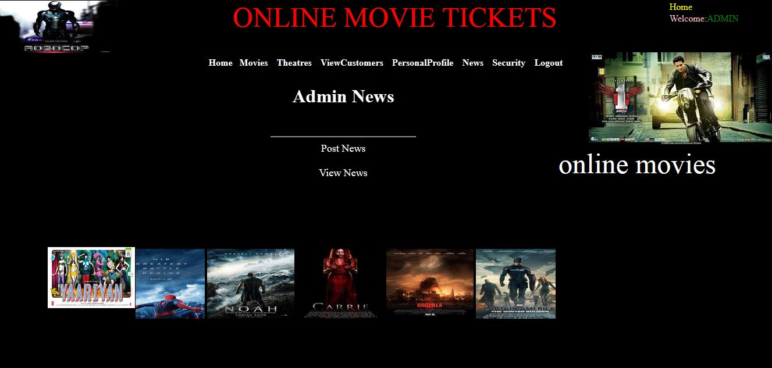
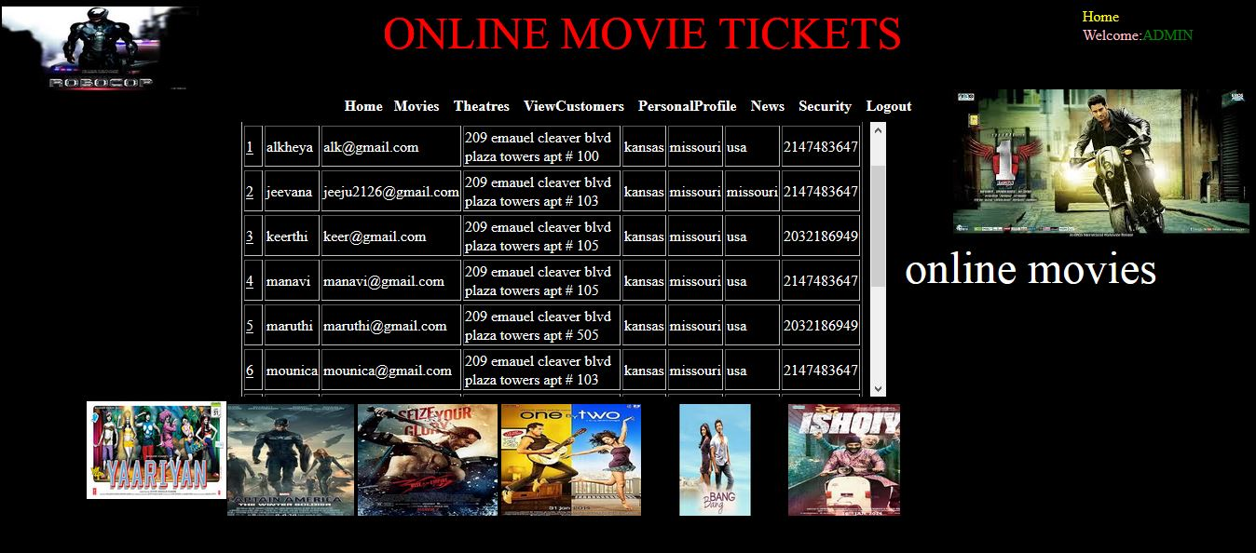

Slide 12
THANK YOU

